Slide 1
A Comprehensive Approach for Extreme Weather Event Forecasting Using Machine Learning & Data Science
By: Tariq Aziz Supervisor: Dr. Muhammad Fayaz Co-supervisor: Dr. Azmat Hussain
Forecasting Today, Protecting Tomorrow 🌍

Slide 2

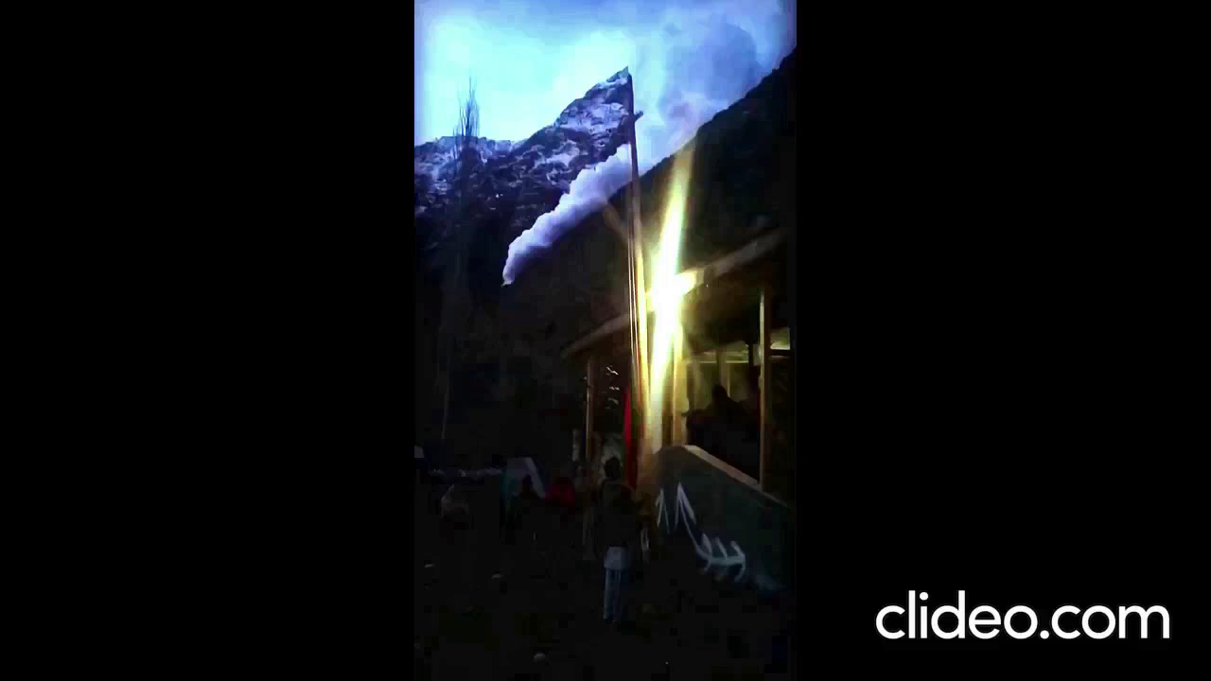
Motivation

Slide 3
Objectives
Proposed Solution
Business Benefits
Dataset & Model Selection
Evaluation Metrics Summary
Implementation Details
Contributions & Future Work
Outline

Slide 4






Build robust ML models for Drought, Avalanche, and Landslide prediction
Integrate real-time weather input via external APIs.
Develop a responsive web interface.
Enable visualization of predictions.
Store and analyze prediction logs for monitoring trends.

Slide 5

🌐 An intelligent system for forecasting disaster risks using machine learning
Proposed Solution
03
04
05
🔄 Integrated with real-time weather data.
💻 Web-based dashboard with maps and graphs.
🧠 Backend powered by ML models for each disaster type.

Slide 6






Business Benefits
Early Risk Detection
Cost Reduction
Data-Driven Decisions
Scalable Solution
Transparency
Public Engagement

Slide 7

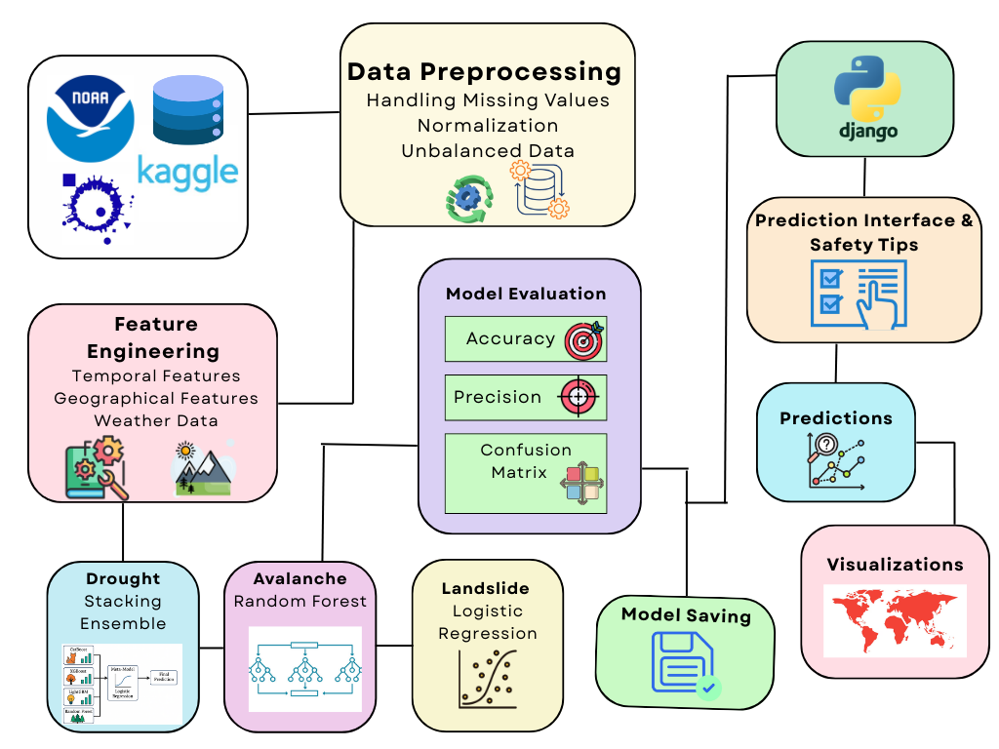
Schematic Diagram

Slide 8
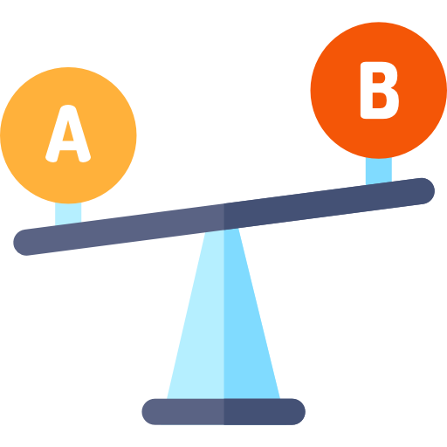



Dataset and Model Selection
99,984 rows
Compared multiple models
Drought
Temp, Pressure, Wind, etc.
Grid Search for hyperparameter tuning
881,934 rows
Avalanche
Elevation, Snow Depth, Wind Speed
K-fold cross-validation
5,000 rows
Landslide
Soil Moisture, Precipitation, Humidity

Slide 9












Model Selection

Slide 10
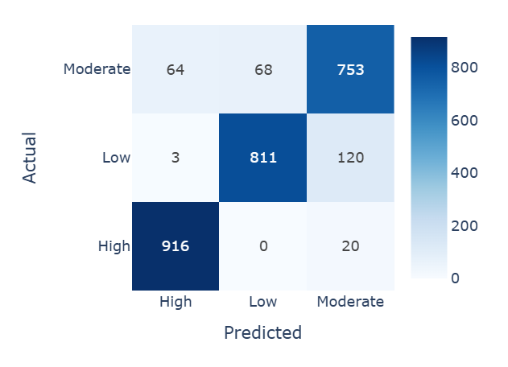
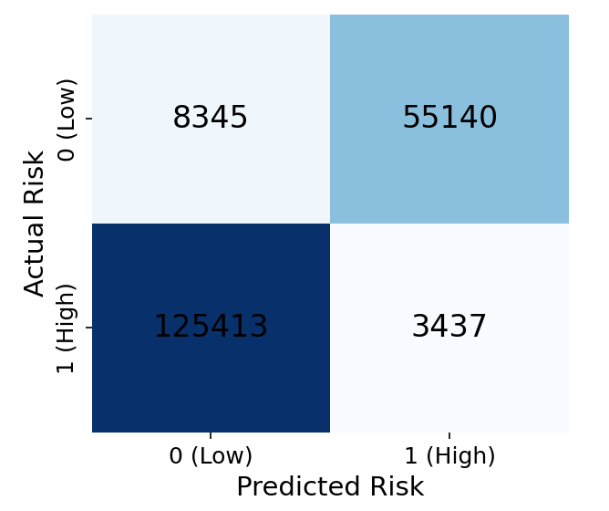
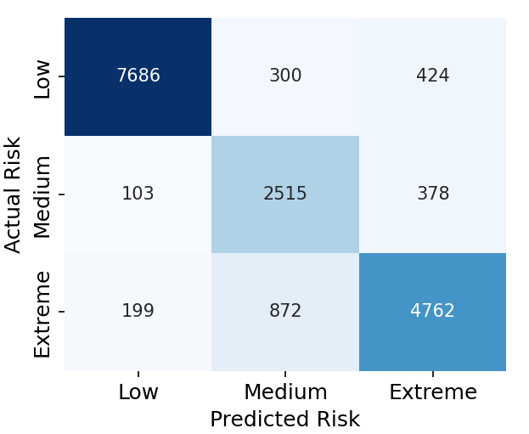
Evaluation Metrics Summary
Landslide Model
Avalanche Model
Drought Model
Accuracy: 0.89
Recall: 0.90
F1-score: 0.90
Precision: 0.91
Accuracy: 0.87
Recall: 0.86
F1-score: 0.90
Precision: 0.84
Accuracy: 0.83
Recall: 0.71
F1-score: 0.74
Precision: 0.78

Slide 11

Implementation Details
Django
HTML, CSS, JavaScript, Bootstrap 5
Joblib
OpenWeatherMap API
SQLite
Plotly

Slide 12
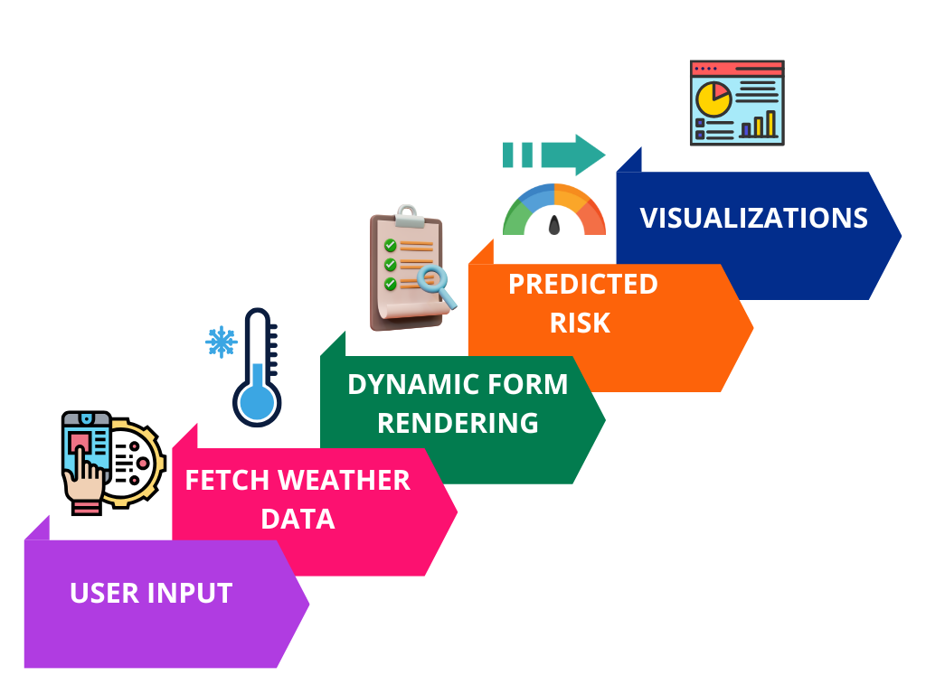
System Workflow

Slide 13

Frontend and UI Design

Slide 14
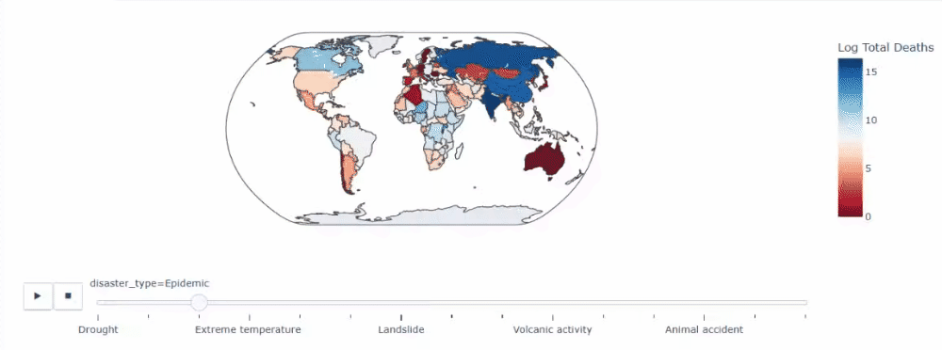
Graphical Dashboard

Slide 15




Contributions and Conclusion
Unified system for multi-disaster prediction
Applied 9 Machine Learning Models
High accuracy across multiple models
Real-time Prediction

Slide 16




Future Work
Integration of satellite/IoT sensor data
Mobile app version
Multi-language Support
Integration with NDMA, Pakistan

Slide 17



Slide 18

Appendix

Slide 19
Model Comparison
Disaster | Model | Train Accuracy | Test Accuracy | Cross-Validation Score
Landslide | Logistic Regression | 89.7% | 90.0% | 89.6% ± 1.1%
Landslide | Decision Tree | 78.0% | 76.5% | 75.9% ± 2.0%
Landslide | SVM (Linear Kernel) | 82.5% | 81.0% | 80.8% ± 1.5%
Avalanche | Random Forest | 88.0% | 86.0% | 85.8% ± 0.1%
Avalanche | K-Nearest Neighbors (k=5) | 75.0% | 72.5% | 73.2% ± 2.4%
Avalanche | AdaBoost Classifier | 81.5% | 80.0% | 79.8% ± 1.3%
Drought | Stacking Ensemble | 84.5% | 82.0% | 81.5% (±1.7%)
Drought | Random Forest | 78% | 76.2% | 75.8% (±1.5%)
Drought | XGBoost (alone) | 79.5% | 75.5% | 77.9% (±1.2%)

Slide 20
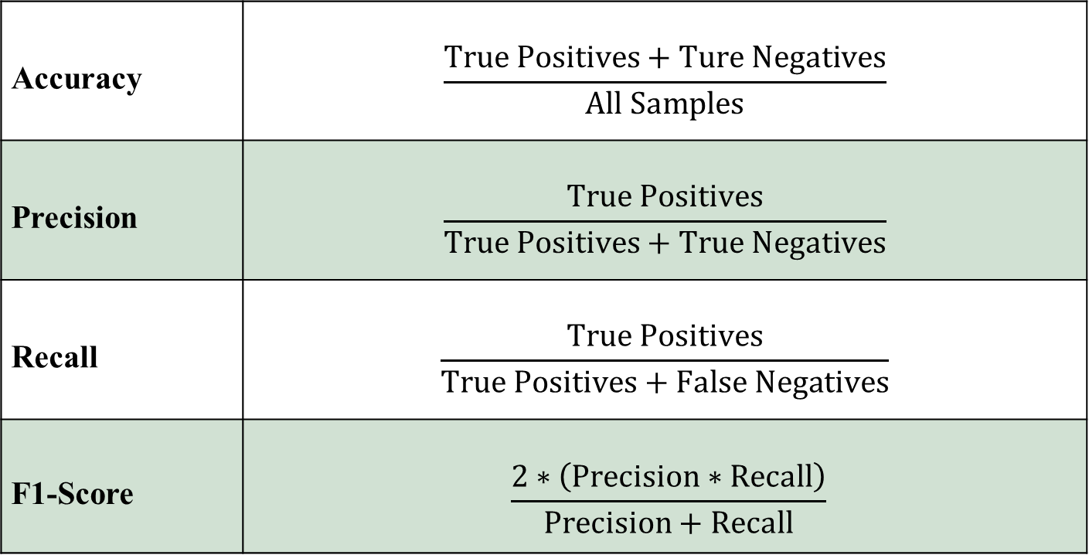
Performance Metrics
Accuracy | $$\frac{True Positives+Ture Negatives}{All Samples}$$
Precision | $$\frac{True Positives}{True Positives+True Negatives}$$
Recall | $$\frac{True Positives}{True Positives+False Negatives}$$
F1-Score | $$\frac{2∗\left(Precision∗Recall\right)}{Precision+Recall}$$

Slide 21
Models Description
Logistic Regression A linear model that estimates the probability of a class using the sigmoid function. Simple, fast, and effective for linearly separable data.
Decision Tree Decision tree is a predictive modeling method widely used in machine learning, statistics, and data mining. The tree model is used to go from observations/features about an item to conclusions about the target variable.
SVM SVMs maps training examples to points in space so to maximize the width of the gap between the two categories. They form the hyperplane or a set of hyperplanes in a n- dimensional space, which can be used for classification, regression, or tasks of outlier detection

Slide 22
Models Description
Random Forest An ensemble of decision trees using bagging. It reduces overfitting and captures complex feature interactions.
K-Nearest Neighbors K-NN is based on the principal to find a predefined number of training samples closest in distance to the new point, and hence, predicts a label using these.
AdaBoost Classifier (Avalanche) Boosts weak learners by focusing on misclassified samples. Improves accuracy iteratively.

Slide 23
Models Description
Stacking Ensemble Combines multiple models via a meta-learner. Leverages strengths of diverse algorithms for better performance.
CatBoost A gradient boosting model optimized for categorical data. Reduces overfitting and requires minimal preprocessing.
XGBoost A regularized gradient boosting model. Efficient, scalable, and handles missing data well.
LightGBM A fast gradient boosting framework that uses histogram-based splits. Ideal for large datasets and high speed.

Slide 24
SMOTE & Cross-validation
Cross-validation
Cross-validation is a technique used to check how well a machine learning model performs on unseen data. It splits the data into several parts, trains the model on some parts and tests it on the remaining part repeating this process multiple times.
SMOTE
SMOTE (Synthetic Minority Oversampling Technique): Imbalanced datasets impact the performance of the machine learning models and the Synthetic Minority Over-sampling Technique (SMOTE) addresses the class imbalance problem by generating synthetic samples for the minority class. SMOTE

Slide 25

Challenges Faced
Delayed data cleaning due to missing labels
Unbalanced datasets
Feature engineering- lack of correlation
Weather API instability at times
Combining ML with live API was non-trivial

